Slide 1
Math competence test reinforcement
3rd Term

Slide 2
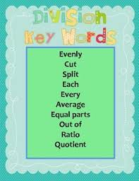
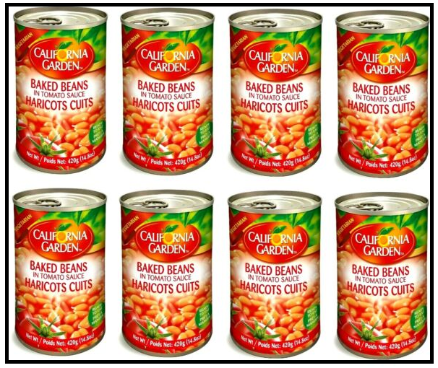
Division of decimal numbers
A package of 8 cans of sauce weighs 44.8 pounds, what is the weight of each can?

Slide 3
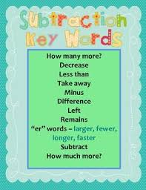

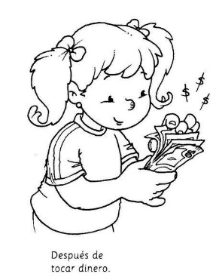
Addition of decimal numbers
Megan has $23.75 in the bank. She finds eight cents in the jacket, and her dad gives her $0.25. How much money does Meg have now?

Slide 4

Multiplication of decimal numbers
Julia works part-time, she earns $18.5 dollars per hour and she worked 8.3 hours last week. How much money is she going to receive?

Slide 5
Division of decimal numbers
In the past “Books Fair”, Sophie bought a collection of 10 units, she paid $250.45. What is the cost of each book if they all cost the same?

Slide 6
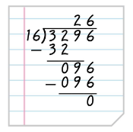
Division of whole numbers
Michelle divides 3296 by 16 using the long division shown. But when she checks, she finds that 26 x 16 = 416. What did she do wrong?

Slide 7
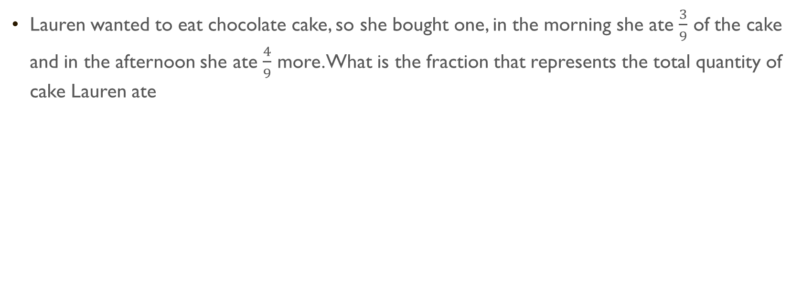
Addition of fractions
Lauren wanted to eat chocolate cake, so she bought one, in the morning she ate $\frac{3}{9}$ of the cake and in the afternoon she ate $\frac{4}{9}$ more. What is the fraction that represents the total quantity of cake Lauren ate

Slide 8
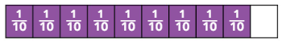
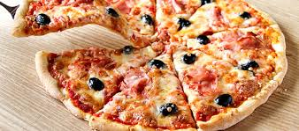
FRAction models
Write a situation that represents this fraction model

Slide 9

ADDITION of decimal numbers
Sara is going to combine the decimal numbers to make the target value. The numbers that combine to make 1.0 are:
1.0

Slide 10
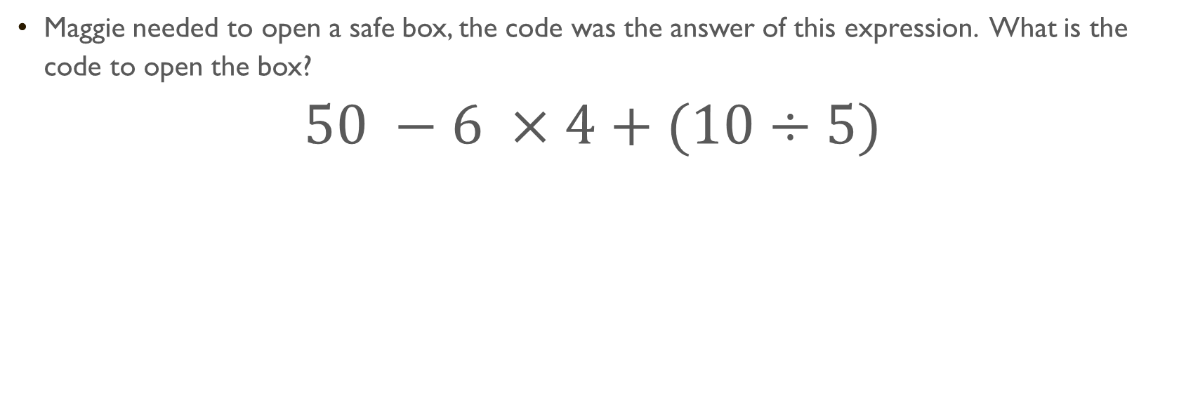
Order of operations
Maggie needed to open a safe box, the code was the answer of this expression. What is the code to open the box?
$$50 −6 ×4+(10÷5)$$

Slide 11
Addition and subtraction of decimal numbers
In 2015, an accident released wastewater into Colorado waterways. The EPA provided $1.94 million to help with cleanup and water quality testing. Other organizations donated money. Then the EPA promised to provide another $1.15 million. This will bring the total amount of donations to $5.26 million. How much money has been contributed from other organizations?

Slide 12
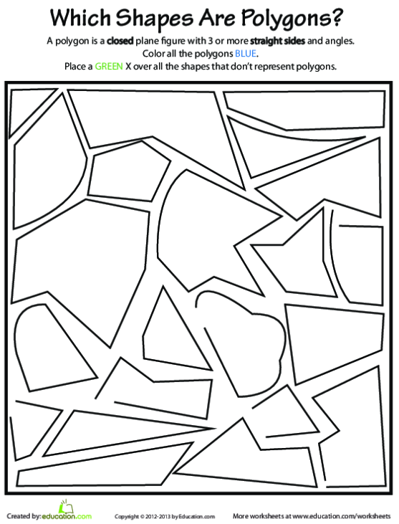
polygons

Slide 13
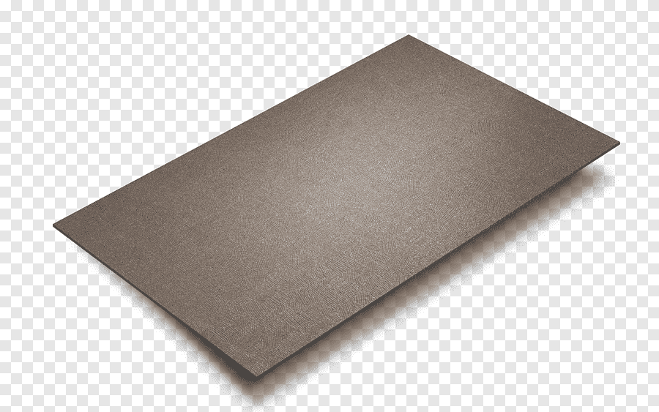
Area of quadrilaterals
A rectangular piece of metal is 8 centimeters long and 6 centimeters wide. What is its area?

