Slide 1


Synthesis Project
Decimal numbers

Slide 2
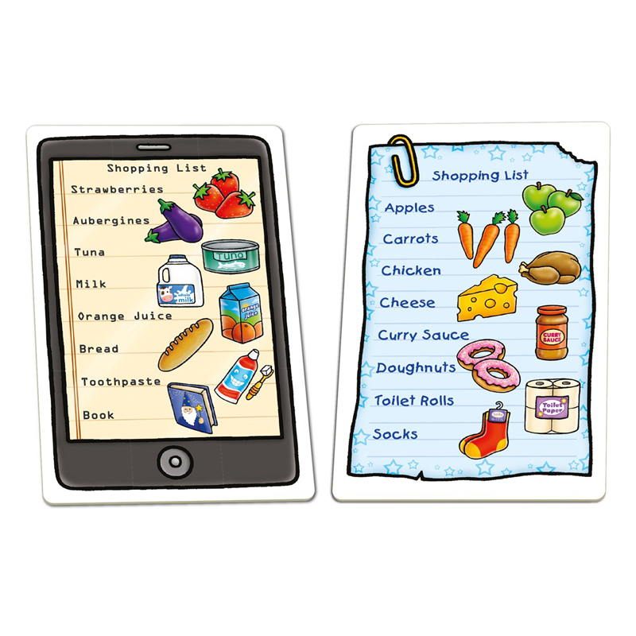
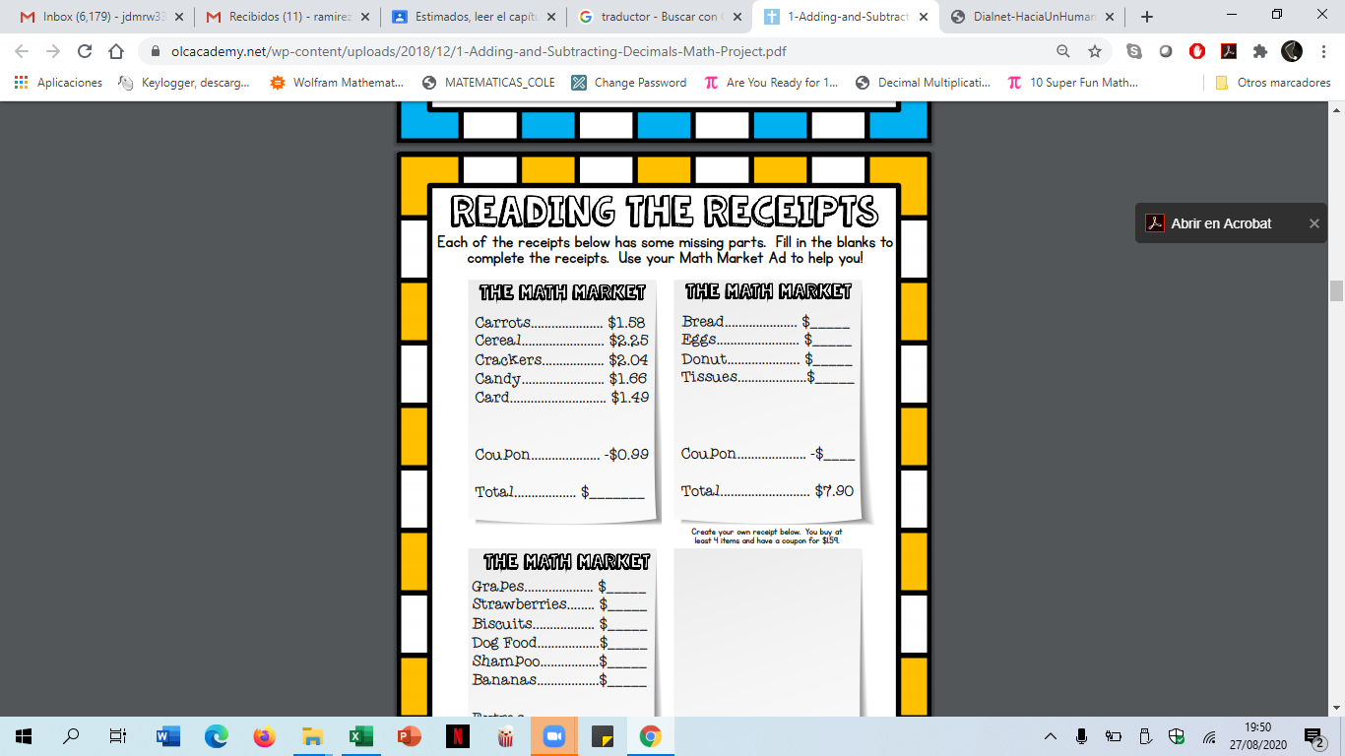
STEPS
1. To make a Shopping list (10 products).

Slide 3
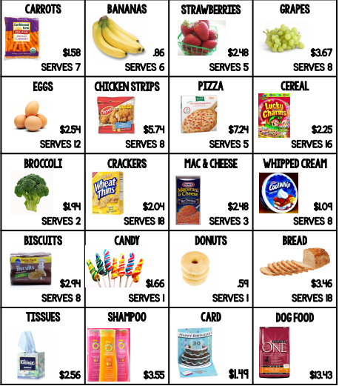
2. Give decimal prices to those products.

Slide 4
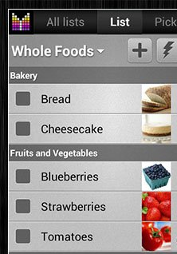
3. To write the quantity you will buy of each product.
3
2
1
1
5

Slide 5
3. To find the total price of each product.
4. Organize total prices from cheapest to most expensive (lower price to higher price).
5. To find the total price of your product list.

