Slide 1
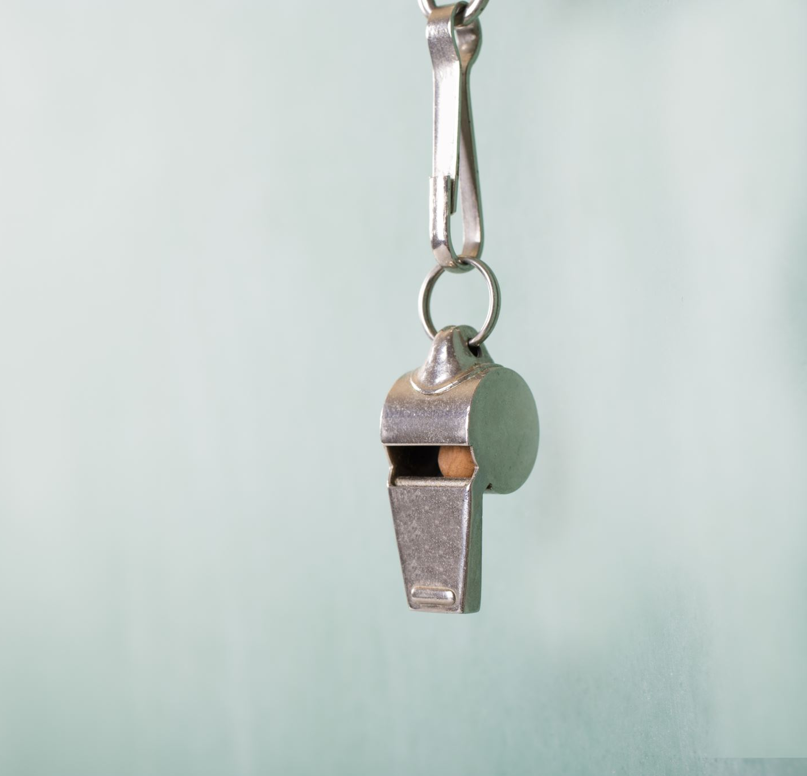




COMPETENCE TEST REINFORCEMENT
Date: Wednesday, Oct 28th /2020
$$Game$$

Slide 2
TOPICS
Equivalent fractions
Multiplication of whole numbers
Addition of decimal numbers
Line plots
Customary Units of Capacity
Coordinate plane
Polygons
Triangles

Slide 3
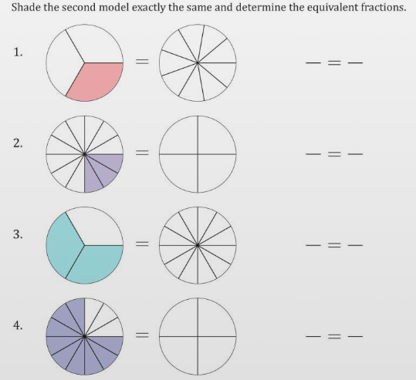
1. EQUIVALENT FRACTIONS

Slide 4
2. Multiplication of whole numbers
There are 215 photographers who take pictures for the city newspaper. For yesterday's issue, each photographer took 310 pictures. How many pictures were there in all?

Slide 5
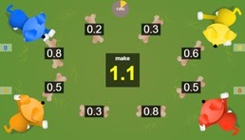
3. Addition of decimal numbers
Sara is going to combine the decimal numbers to make the target value. The numbers that DO NOT combine to make 1.0 are:
1.0

Slide 6
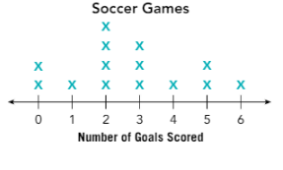
4. Line plots
4.1 In how many games were 3 or more goals scored?

Slide 7
4.2 How many games are represented in the line plot?

Slide 8
4.3 How many goals were scored during the soccer season?

Slide 9
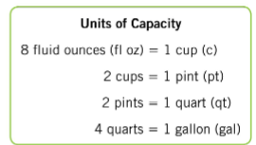


5. Customary Units of Capacity
Sasha is going to have a party with 9 friends. She is going to give a pint of soda to each person, including herself, so in total she will need 10 pints. How many gallons of soda does she need to her party?
Gallons
Quarts
Pints
Cups
Fluid Ounces
$$×$$
$$÷$$

Slide 10
A pitcher of lemonade is made for a children's party. Enola says there are 2.5kL of lemonade in the pitcher. We can say that:
Enola is correct, because a pitcher has a capacity of 2,500 liters
Enola is wrong, because kL is a unit of mass
Enola is correct, because we measure the capacity only using the metric system
Enola is wrong, because even when the kL is a unit of capacity, the pitcher is too small

Slide 11
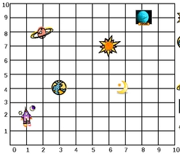
6. Coordinate plane
6.1) Tom is going to visit the planetarium. The coordinate plane shows the location of 6 space elements. If he wants to see the Sun, so he needs to go to the coordinate:

Slide 12
6.2) If he wants to see the Earth, so he needs to go to the coordinate:

Slide 13
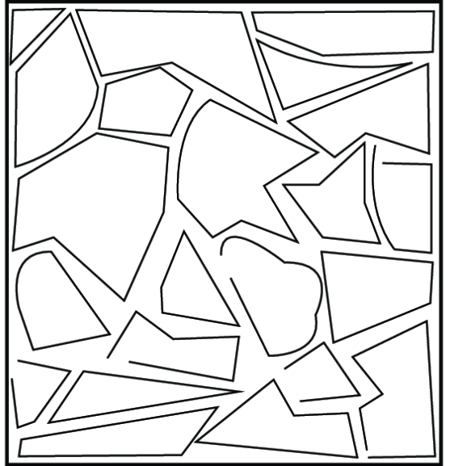
7. Polygons

Slide 14
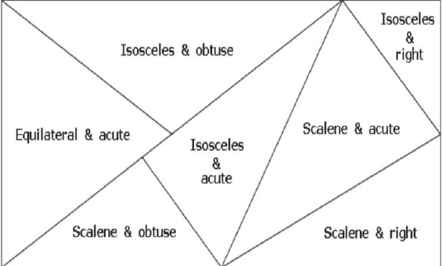
8. Triangles
Write true or false according to the characteristics

Slide 15

Do it very well in the test

